Slide 1

Monitor Support Activities
CHCCCS031 - Provide individualised support (Release 1)

Slide 2


Monitor:
Refers to observing the person's progress with the provided support services
Is the first step in ensuring that their individualised plan is effective
What you will monitor can be used to improve and maintain their well-being.
The information can also ensure that their rights are respected by all those involved in providing their support.
Monitor Support Activities

Slide 3

3.1 Monitor Own Work

Slide 4
You must ensure that the support you provide is within a quality framework, which is a set of ideas, concepts, findings and laws that support and regulate a system.
The standards of support depend on the service delivery model of your organisation. A service delivery model describes:
The type of services the organisation provides
How the organisation will provide their services to their clients
Monitor Support Activities

Slide 5
Below are the service delivery models in the individualised support sector:
Home Care Service Model
Residential Care Service Model
Organisations using this model provide services to clients who are able to live in their own homes but require some help.
Organisations using this model provide services to clients who are no longer able to live independently at home.
Monitor Support Activities

Slide 6
Below are the service delivery models in the individualised support sector:
Respite Care Service Model
Community Support Service Model
Organisations using this model provide services to clients who need support for a set period of time.
Organisations using this model provides services to clients who wish to participate fully in their communities.
Monitor Support Activities

Slide 7
3.1.1 Standards of Support
A standard is an established document that sets out rules to ensure quality.
Standards provide a basis for people on what they should expect from a product, service or system.
Below are the standards set that a care worker must follow when providing support:
Legislated and statutory standards
Professional standards
Ethical standards
Monitor Support Activities

Slide 8
Below are the standards set that a care worker must follow when providing support:
Legislated and statutory standards are required by established laws and rules. A state or territory sets these laws and regulations.
Professional standards define the nature and quality of care provided. Professional standards guide the practice, interactions and relationships of a care worker.
Ethical standards are established by an organisation to communicate their moral values. They serve as a reference during decision making and guide a support worker’s behaviour.
Monitor Support Activities

Slide 9
A disability support worker must follow the National Standards for Disability Services’ six national standards:
Rights
Participation and inclusion
Individual outcomes
Feedback and complaints
Service access
Service management
Monitor Support Activities

Slide 10
An aged care worker must follow the eight standards of the Aged Care Quality Standards:
Consumer dignity and choice
Ongoing assessment and planning with consumers
Personal care and clinical care
Services and supports for daily living
Organisation’s service environment
Feedback and complaints
Human resources
Organisational governance
Monitor Support Activities

Slide 11
3.1.2 Monitoring Own Work to Ensure the Standard of Support is Maintained
Consider then the following when monitoring your own work to ensure the required standard of support is maintained:
Regularly review your organisation’s policies and procedures.
Ask your supervisors and co-workers for their observations.
Ask for feedback from your clients.
Direct Observation
The observer is present and directly watching and guiding the person being observed.
Indirect Observation
The observer is easily reachable but not directly watching the person being observed.
Monitor Support Activities

Slide 12

3.2 Identify, Respond to and Report Situations of Risks

Slide 13
Risk is the likelihood that something will harm or affect a person’s safety and wellbeing.
Situations of potential risk are instances where there is a possibility that a person will be exposed to harm.
Situations of actual risk are instances where there is a confirmed possibility.
Monitor Support Activities

Slide 14
3.2.1 Situations of Potential or Actual Risk
A care worker must always be on the lookout for situations of potential or actual risk.
To do so, one must be familiar with the different kinds of hazards.
A hazard is any source that can potentially harm or affect a person.
Common examples of hazards include:
Safety hazards
Biological hazards
Environmental hazards
Ergonomic hazards
Chemical hazards
Monitor Support Activities

Slide 15
Hazardous Manual Handling Scenarios
Manual handling is any activity that requires the use of force by a person to move something or someone.
Hazardous manual handling refers to handling that has characteristics such as:
Repetitive or sustained use of force
Sustained awkward posture
Monitor Support Activities

Slide 16
Hazardous manual handling refers to handling that has characteristics such as:
Repetitive movement
Application of extreme force
Manual handling loads that are unstable or difficult to grasp and hold
Manual handling live people or animals
Monitor Support Activities

Slide 17

Hazardous manual handling can cause injuries to you or the client, such as:
Sprains and strains
Back injuries
Soft-tissue injuries to wrists, arms, shoulders, neck or legs
Hernias
Chronic pain
Monitor Support Activities

Slide 18
3.2.2 Recognising and Responding to Situations of Potential or Actual Risk
Risk management is the process of identifying, assessing and controlling the risk of hazards.
Below is the process of risk management:
Hazard identification
Risk assessment
Monitoring and review
Risk control
Monitor Support Activities

Slide 19
Below is the process of risk management:
Hazard identification
The first step to managing risk is to identify all hazards within the environment.
This also includes identifying all possible events in which risk is presented.
Monitor Support Activities

Slide 20
Below is the process of risk management:
Hazard identification
To identify possible situations of risk during support activities, you must monitor the following within the environment:
Substances used by clients and other staff
Equipment used by clients and other staff
Moveable items used by clients and other staff
Other people
Monitor Support Activities

Slide 21
Below is the process of risk management:
Risk assessment
Once you have identified the hazards within the environment, you must consider:
The severity of the harm which can be caused by the hazard
The likelihood of the harm occurring
Monitor Support Activities

Slide 22
Below is the process of risk management:
Risk control
A hierarchy of control is used as a means of determining how to implement feasible and effective control solutions.
The hierarchy is depicted in the next slide.
Monitor Support Activities

Slide 23
Elimination
Substitution
Engineering controls
Administration controls
Removing an existing hazard
Replace the hazard with something safer
Use mechanical devices or processes to minimise exposure to a hazard
Work methods or procedures that are designed to minimise exposure to a hazard
PPE
Protect the person with the use of suitable Personal Protective Equipment
Isolation
Isolate the hazard from people
Monitor Support Activities

Slide 24
Below is the process of risk management:
Monitoring and review
The last step in managing risks is to monitor and review the changes made to control the level of risk. You must:
Ensure that the methods used have been effective in minimising the risk identified in the hazard
Monitor for any new risks or hazards during the implementation of the control methods.
Monitor Support Activities

Slide 25
Risk Management Considerations
The following must be taken into consideration when managing risks for clients:
Self-neglect
Behaviours of concern
Impaired judgement and problem-solving abilities
Impaired cognitive functioning
A sudden or unexpected change in health status include sensory loss
Uneven floor surfaces
Monitor Support Activities

Slide 26
Risk Management Considerations
The following must be taken into consideration when managing risks for clients:
Physical obstructions
Poor home maintenance
Poor or inappropriate lighting
Inadequate heating and cooling devices
Privacy and confidentiality due to inadequate security
Social rights infringements
Monitor Support Activities

Slide 27
3.2.3 Ways to Respond to Identified Risks
Consider the tables below for the examples of risks typical in individual support settings and what you can implement to minimise the risk.
Risk | Ways to minimise risk
Abuse, Neglect and Exploitation | Watch out for indicators of abuse/neglect (e.g. unexplained bruises, missing jewellery or cash, etc.) Follow organisational policies and procedures for reporting and documenting suspected abuse and or neglect.
Monitor Support Activities

Slide 28
Consider the tables below for the examples of risks typical in individual support settings and what you can implement to minimise the risk.
Risk | Ways to minimise risk
Social Rights Infringement | Support clients in accessing and using feedback and complaints systems. Support clients in understanding and exercising their own rights.
Monitor Support Activities

Slide 29
Consider the tables below for the examples of risks typical in individual support settings and what you can implement to minimise the risk.
Risk | Ways to minimise risk
Fall Risks | Conduct fall risk assessment according to organisational policies and procedures. Support clients and their carer in managing hazards that increase the risk of falling.
Monitor Support Activities

Slide 30
Consider the tables below for the examples of risks typical in individual support settings and what you can implement to minimise the risk.
Risk | Ways to minimise risk
Fall Risks | Provide anti-slip mats; or support clients to use handrails (as per the individualised support plan). Follow transfer and mobility plans set out by allied health professionals and assist clients to use equipment.
Monitor Support Activities

Slide 31
3.2.4 Reporting to Supervisor
All situations of risk must be reported according to organisational policies and procedures as it is essential in ensuring the effectiveness of risk management.
Ways to report situations of risk:
Incident reports - formal documents that record the detail of any unusual occurrence
Hazard log - includes information on the hazards found in the workplace environment
Monitor Support Activities

Slide 32

3.3 Involve the Person in Discussions and Identify Need for Changes

Slide 33
Clients are more capable of determining what opportunities they would like to take due to the following reasons:
They know and understand their own experiences better than anyone.
They may have feelings or emotions that others may not understand.
They may have desires or preferences that might not make sense to others.
They can speak and thus may provide more detailed or specific information on what they need help with.
Monitor Support Activities

Slide 34
Involving the client provides the following benefits:
It frames the client as capable of making operational decisions rather than seeking help from others.
It strengthens the client’s understanding of their strengths and limitations.
It encourages the client to take part in activities, routines and programs they choose.
Monitor Support Activities

Slide 35
3.3.1 Involving Clients in Discussions About Their Support Services
By involving your clients in these discussions:
You can ensure that the client can properly communicate with you and anyone who is involved in their individualised plan
The client can directly confirm whether the support services are meeting their goals, needs and preferences
Can ensure that any changes to be made in the individualised plan suit their preferences
Monitor Support Activities

Slide 36
During the discussion, you may ask questions about clients’ experiences with their support services, such as:
Did the support services meet your needs, goals and preferences?
What need, goal or preference was not met by the support services?
What do you think should be done to address the unmet need, goal or preference?
Were there any issues regarding staff availability or resources needed?
How do the issues impact the effectiveness of the support services?
Monitor Support Activities

Slide 37
3.3.2 Confirming Any Requirement for Change
Requirement for change refers to an aspect of the individualised plan that has not met the client’s goals, needs or preferences. To identify any requirement for change, you may use the following strategies:
Review the individualised plan.
Ask relevant personnel for their observations.
Observe the client.
Interview the client’s family and friends.
Monitor Support Activities

Slide 38
You can gain confirmation for the identified requirements for change by doing the following:
Summarising your findings – provide your clients with key points so they can share their own input the requirements for change
Asking appropriate questions – ask your client’s about their needs, goals and preferences that were not met. Ask them as well why they feel these were not met and how they think it can be met.
Monitor Support Activities

Slide 39
You can gain confirmation for the identified requirements for change by doing the following:
Presenting a modified care plan – discuss the proposed changes to the care plan with your client and others involved in their care.
Reaching an agreement – discuss the final agreed points to allow for last-minute changes.
Monitor Support Activities

Slide 40
Industry Best Practices
You can also review current best practice approaches for the delivery of person-centred care when identifying requirements for change which include:
Person feedback reporting and complaints processing
Person access to information and education
Monitor Support Activities

Slide 41
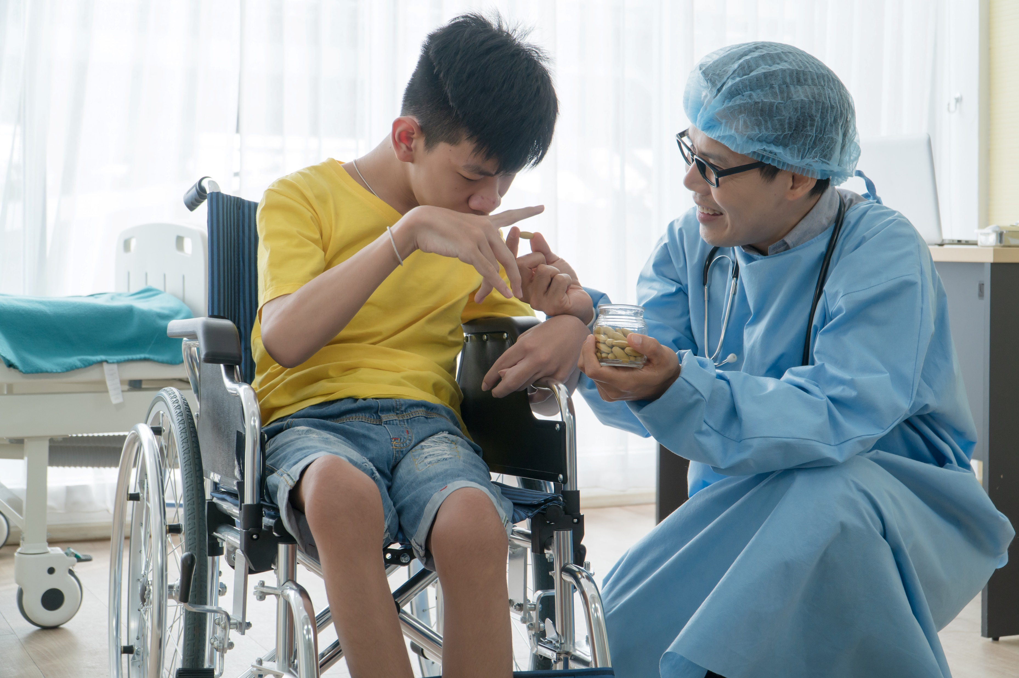
3.4 Identify, Report and Refer Signs of Additional or Unmet Needs of the Person

Slide 42
Additional needs refer to the changing needs of the client. These can include the following:
Change in barriers
The model contextualises disability as the barriers people face in society due to their impairments.
Change in interest
Goals do not depend solely on a person’s skills to live a quality life; they also rely on the person’s level of interest.
Monitor Support Activities

Slide 43
Unmet needs refer to the needs of clients that were not satisfied by their support services.
Some behaviours are results of unmet needs and could be:
Biological
Emotional
Social
Monitor Support Activities

Slide 44
Recognising Signs of Additional or Unmet Needs
You can try the following strategies to recognise when your clients are displaying signs of additional or unmet needs:
Keep track of their physical needs.
Check on their mental health.
Analyse their behaviour.
Monitor Support Activities

Slide 45
3.4.1 Ways of Responding to Additional or Unmet Needs
Some ways to respond to a client’s additional or unmet needs are:
Discussions
Discussions refer to conversations with your clients regarding a specific topic.
Reporting
Reporting can be done in two ways:
Verbal report to supervisor
Written report for documentation
Monitor Support Activities

Slide 46
Some ways to respond to a client’s additional or unmet needs are:
Referrals
A referral is a process of connecting to other staff and support services outside of your area of expertise.
Referrals can be categorised in two ways:
Warm referral
Cold referral
Monitor Support Activities

Slide 47
3.4.2 Referring Clients According to Organisational Policies and Procedures
You can refer to the following procedure when referring the person to other staff:
Identify the part of the client’s care that falls outside your area of expertise.
Identify other staff members you can refer the client to.
Before contacting the other staff member, explain why you plan to refer their care to another staff member.
Monitor Support Activities

Slide 48
You can refer to the following procedure when referring the person to other staff:
Define the role of the staff member.
Contact the staff member directly to discuss the referral.
Document and report the referrals.
Monitor Support Activities

Slide 49
Referrals to Other Support Services
You can refer to the following procedure when referring to other support services:
Identify what support the client needs.
Develop a list of available support services.
Present the list of available services to the client.
Monitor Support Activities

Slide 50
You can refer to the following procedure when referring to other support services:
Once the client agrees to a service, contact the service on their behalf with a warm referral.
Define the role of the service.
Record and report the referrals.
Monitor Support Activities

Slide 51
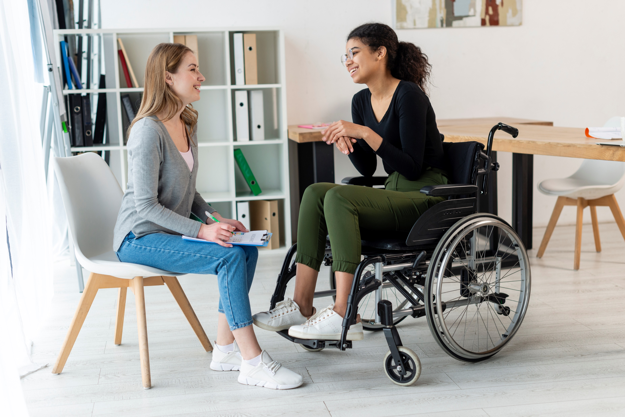
3.5 Identify and Report Gaps in Assistive Technology Needs

Slide 52
When consulting with your clients to ascertain gaps in assistive technology, you may consider the following strategies:
Ask for feedback from the client.
Observe the client.
Ask the client’s support team for their observations.
Monitor Support Activities

Slide 53

3.6 Support and Respect the Person During Discussions

Slide 54
When consulting with your clients to identify gaps in assistive technology, you may consider the following strategies:
Support clients’ self-determination.
Respect their rights, privacy, and dignity.
Monitor Support Activities

Slide 55

3.6.1 Supports Clients’ Self-Determination
Motivation:
Is an essential aspect of the wellbeing of people receiving support
Allows a person to engage in activities and become receptive to strategies designed to address their needs, goals, and preferences.
Determine Personal Support Requirements

Slide 56
There are two kinds of motivation:
Internal motivation
Refers to satisfaction of applying oneself is enough to encourage a person to accomplish their goals
Determined by the values and goals of the person
External motivation
Refers to external rewards such as praise and approval are used as motivators
Determined by the values and goals of others (e.g., family, friends, caregivers)
Monitor Support Activities

Slide 57
One of the critical factors that can affect a person’s motivation is the theory of self-determination.
Self-determination:
Refers to a person’s ability to make their own choices, actions and decisions
Involves providing specific needs to allow a person to feel free in directing themself
Monitor Support Activities

Slide 58
It would help to address the following needs to allow a person to develop a greater sense of self-determination:
Competence
Refers to a person’s need to feel that they have sufficient skills and intellect.
Relatedness
Refers to a person’s need to feel a sense of attachment, closeness and belonging to a social group.
Monitor Support Activities

Slide 59
It would help to address the following needs to allow a person to develop a greater sense of self-determination:
Refers to a person’s need to feel that they control their own choices and decisions.
Autonomy
Monitor Support Activities

Slide 60
To support clients’ self-determination when participating in discussions with them and your supervisors, you must be able to do the following:
Determine what motivates the client.
Foster a growth mindset.
Develop meaningful relationships with the client.
Monitor Support Activities

Slide 61

3.6.2 Respects Clients’ Rights, Privacy and Dignity
Respect refers to believing that the person is valued.
By respecting your clients’ rights, privacy, and dignity, you can build up their feelings of trust, safety, and wellbeing.
Monitor Support Activities

Slide 62
To respect clients’ rights, privacy and dignity when participating in discussions with them and your supervisors, you must be able to do the following:
Treat the client as you would anyone else.
Use people-first language.
Do not make assumptions for the client.
Avoid patronising the client.
Support the client’s choices and decisions.
Follow the procedures on privacy, confidentiality and disclosure.
Monitor Support Activities

Slide 63

What have we learnt?
In this part of the session, we have covered:
Determine personal support requirements
Provide support services
Monitor support activities
Complete reporting and documentation

Slide 64
End of Chapter 3

